Slide 1
Chapter 10 – Logistic Regression
Data Mining for Business Analytics in Python
Shmueli, Bruce, Gedeck & Patel

Slide 2
Logistic Regression
Extends idea of linear regression to situation where outcome variable is categorical
Widely used, particularly where a structured model is useful to explain (=profiling) or to predict
We focus on binary classification
i.e. Y=0 or Y=1
Notes:
2

Slide 3
Python Functionality Needed
import numpy as np
import pandas as pd
from sklearn.linear_model import LogisticRegression,
LogisticRegressionCV
from sklearn.model_selection import train_test_split
import statsmodels.api as sm
from mord import LogisticIT
import matplotlib.pylab as plt
import seaborn as sns
from dmba import classificationSummary, gainsChart,
liftChart
from dmba.metric import AIC_score
Notes:
3

Slide 4
The Logit
Goal: Find a function of the predictor variables that relates them to a 0/1 outcome
Instead of Y as outcome variable (like in linear regression), we use a function of Y called the logit
Logit can be modeled as a linear function of the predictors
The logit can be mapped back to a probability, which, in turn, can be mapped to a class
Notes:
4

Slide 5
Step 1: Logistic Response Function
p = probability of belonging to class 1
Need to relate p to predictors with a function that guarantees 0 ≤ p ≤ 1
Standard linear function (as shown below) does not:
q = number of predictors
Notes:
5

Slide 6

The Fix: use logistic response function
Equation 10.2 in textbook
Notes:
6

Slide 7
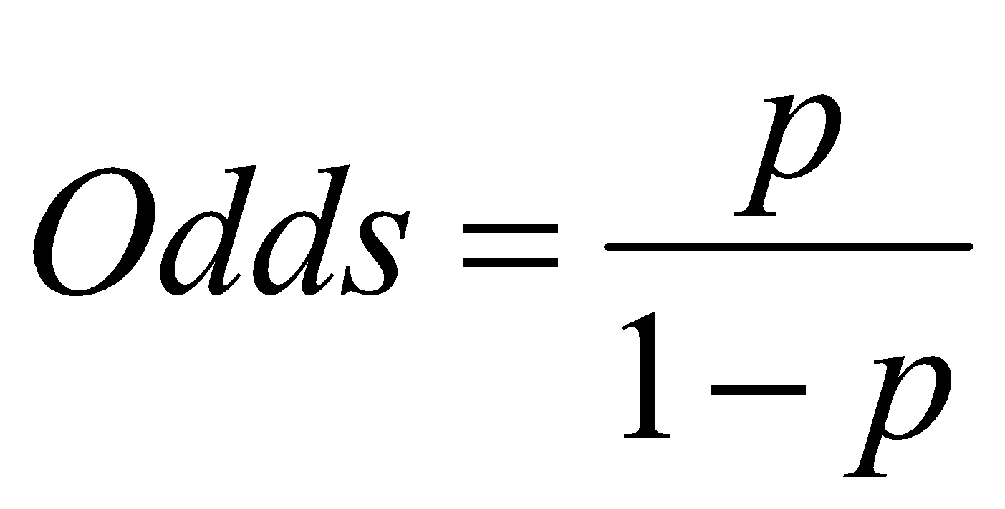
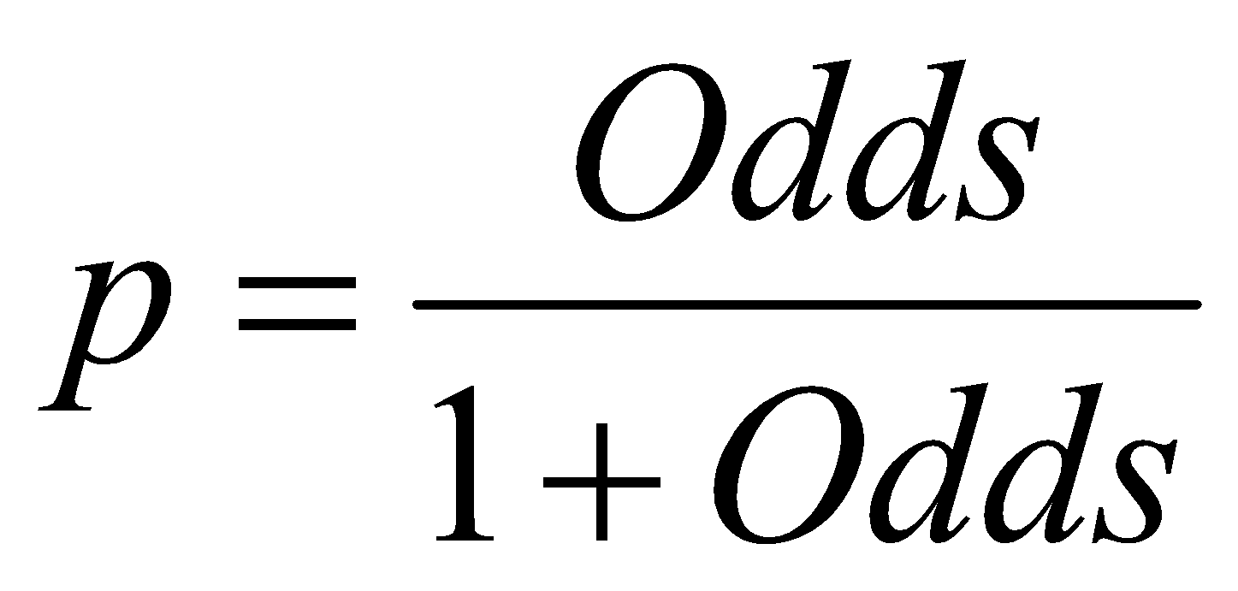
Step 2: The Odds
The odds of an event are defined as:
eq. 10.3
p = probability of event
Or, given the odds of an event, the probability of the event can be computed by:
eq. 10.4

Slide 8
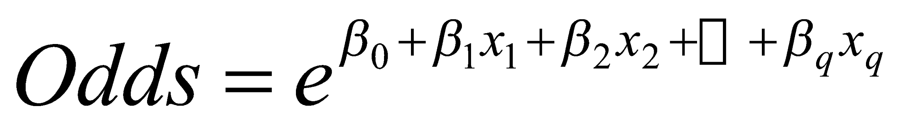
We can also relate the Odds to the predictors:
eq. 10.5
To get this result, substitute 10.2 into 10.4
Notes:
8

Slide 9

Step 3: Take log on both sides
This gives us the logit:
log(Odds) = logit (eq. 10.6)
© Galit Shmueli and Peter Bruce 2017
Notes:
9

Slide 10
Logit, cont.
So, the logit is a linear function of predictors x₁, x₂, …
Takes values from -infinity to +infinity
Review the relationship between logit, odds and probability
Notes:
10

Slide 11
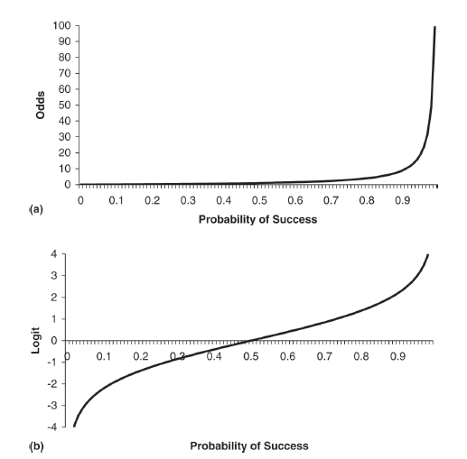
Odds (a) and Logit (b) as function of P

Slide 12
Example
Notes:
12

Slide 13
Personal Loan Offer (UniversalBank.csv)
Outcome variable: accept bank loan (0/1)
Predictors: Demographic info, and info about their bank relationship
Notes:
13

Slide 14

Single Predictor Model
Modeling loan acceptance on income (x)
Fitted coefficients (more later): b₀ = -6.3525, b₁ = -0.0392
Notes:
14

Slide 15
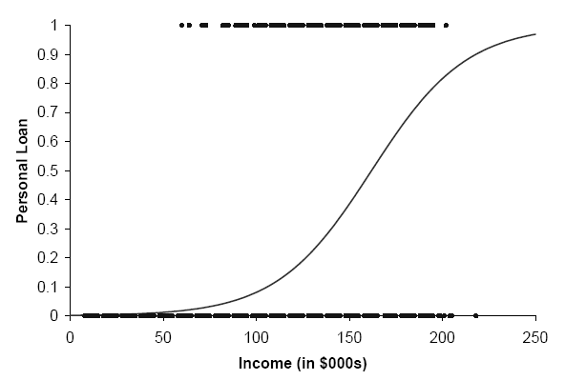
Seeing the Relationship

Slide 16
Last step - classify
Model produces an estimated probability of being a “1”
Convert to a classification by establishing cutoff level
If estimated prob. > cutoff, classify as “1”
© Galit Shmueli and Peter Bruce 2017
Notes:
16

Slide 17
Ways to Determine Cutoff
0.50 is popular initial choice
Additional considerations (see Chapter 5)
Maximize classification accuracy
Maximize sensitivity (subject to min. level of specificity)
Minimize false positives (subject to max. false negative rate)
Minimize expected cost of misclassification (need to specify costs)
Notes:
17

Slide 18
Example, cont.
Estimates of β’s are derived through an iterative process called maximum likelihood estimation
Let’s include all 12 predictors in the model now
Notes:
18

Slide 19
Data Prep
bank_df = pd.read_csv('UniversalBank.csv')
bank_df.drop(columns=['ID', 'ZIP Code'], inplace=True)
bank_df.columns = [c.replace(' ', '_') for c in bank_df.columns]
# Treat education as categorical, convert to dummy variables
bank_df['Education'] = bank_df['Education'].astype('category')
new_categories = {1: 'Undergrad', 2: 'Graduate', 3:
'Advanced/Professional'}
bank_df.Education.cat.rename_categories(new_categories, inplace=True)
bank_df = pd.get_dummies(bank_df, prefix_sep='_', drop_first=True)
y = bank_df['Personal_Loan']
X = bank_df.drop(columns=['Personal_Loan'])

Slide 20
Fitting Model
# partition data
train_X, valid_X, train_y, valid_y = train_test_split(X, y,
test_size=0.4, random_state=1)
# fit a logistic regression (set penalty=l2 and C=1e42 to avoid
# regularization)
logit_reg = LogisticRegression(penalty="l2", C=1e42,
solver='liblinear')
logit_reg.fit(train_X, train_y)
print('intercept ', logit_reg.intercept_[0])
print(pd.DataFrame({'coeff': logit_reg.coef_[0]},
index=X.columns).transpose())
print('AIC', AIC_score(valid_y, logit_reg.predict(valid_X), df =
len(train_X.columns) + 1))

Slide 21
Results
intercept -12.61895521314035
Age Experience Income Family CCAvg Mortgage
coeff -0.032549 0.03416 0.058824 0.614095 0.240534 0.001012
Securities_Account CD_Account Online CreditCard
coeff -1.026191 3.647933 -0.677862 -0.95598
Education_Graduate Education_Advanced/Professional
coeff 4.192204 4.341697
AIC -709.1524769205962
coefficients for logit

Slide 22
Converting to Probability
Notes:
22

Slide 23
Converting from logit to probabilities
logit_reg_pred = logit_reg.predict(valid_X)
logit_reg_proba = logit_reg.predict_proba(valid_X)
logit_result = pd.DataFrame({'actual': valid_y,
'p(0)': [p[0] for p in logit_reg_proba],
'p(1)': [p[1] for p in logit_reg_proba],
'predicted': logit_reg_pred })
# display four different cases
interestingCases = [2764, 932, 2721, 702]
print(logit_result.loc[interestingCases])
actual p(0) p(1) predicted
2764 0 0.976 0.024 0
932 0 0.335 0.665 1
2721 1 0.032 0.968 1
702 1 0.986 0.014 0

Slide 24
Interpreting Odds, Probability
For predictive classification, we typically use probability with a cutoff value
For explanatory purposes, odds have a useful interpretation:
If we increase x₁ by one unit, holding x₂, x₃ … x_{q} constant, then
b₁ is the factor by which the odds of belonging to class 1 increase
Notes:
24

Slide 25
Loan Example: Evaluating Classification Performance
Performance measures: Confusion matrix and % of misclassifications
More useful in this example: gains (lift) (terms sometimes used interchangeably)
Notes:
25

Slide 26
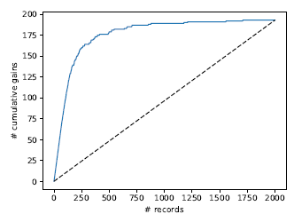
Python’s Gains Chart
df = logit_result.sort_values(by=['p(1)'], ascending=False)
fig, axes = plt.subplots(nrows=1, ncols=2, figsize=(10, 4))
gainsChart(df.actual, ax=axes[0])
liftChart(df['p(1)'], title=False, ax=axes[1])
plt.show()
# of 1’s yielded by model, moving thru records sorted by predicted prob. of being a 1
# of 1’s yielded by selecting randomly

Slide 27
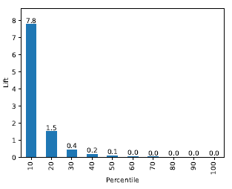
Python’s Lift Chart
df = logit_result.sort_values(by=['p(1)'], ascending=False)
fig, axes = plt.subplots(nrows=1, ncols=2, figsize=(10, 4))
gainsChart(df.actual, ax=axes[0])
liftChart(df['p(1)'], title=False, ax=axes[1])
plt.show()
Top decile (i.e. the 10% most probable to be 1’s) are 7.8 times as likely to be 1’s, compared to random selection

Slide 28
Multicollinearity
Problem: As in linear regression, if one predictor is a linear combination of other predictor(s), model estimation will fail
Note that in such a case, we have at least one redundant predictor
Solution: Remove extreme redundancies (by dropping predictors via variable selection, or by data reduction methods such as PCA)
Notes:
28

Slide 29
Variable Selection
This is the same issue as in linear regression
The number of correlated predictors can grow when we create derived variables such as interaction terms (e.g. Income x Family), to capture more complex relationships
Problem: Overly complex models have the danger of overfitting
Solution: Reduce variables via automated selection of variable subsets (as with linear regression)
See Chapter 6
Notes:
29

Slide 30
P-values for Predictors
Test null hypothesis that coefficient = 0
Useful for review to determine whether to include variable in model
Important in profiling tasks, but less important in predictive classification
Notes:
30

Slide 31
Summary
Logistic regression is similar to linear regression, except that it is used with a categorical response
It can be used for explanatory tasks (=profiling) or predictive tasks (=classification)
The predictors are related to the response Y via a nonlinear function called the logit
As in linear regression, reducing predictors can be done via variable selection
Logistic regression can be generalized to more than two classes
Notes:
31

